Slide 1
Big Mountain Resort

Slide 2
Problem Statement
Big Mountain Resort’s wants to maximize their capitalization of facilities in their resort in additional operating costs by $1,540,000/- over the season.
H
1
Context
4
Constraints within solution space
Big Mountain Resort added a chairlift to better distribute guests throughout the mountain. This season, this extra chair raises their operating expenditures by $1,540,000. The company is eager to hear your suggestions on how to offset the higher running expenses associated with the new chair this season.
The profit margin for business should not exceed 9.2%.
There may not be enough data.
2
Criteria for success
5
Stakeholders to provide key insight
Recommendations to offset $1,540,000 in additional operation costs in order to maintain a 9.2% profit margin. Additionally to project this year’s revenue assuming the recommendations are carried out
Big Mountain Resort Executive Team
Jimmy Blackburn, Director of Operations
Alesha Eisen, Database Manager
6
Key data sources
3
Scope of solution space
CSV file that contains info from the 330 resorts in the US that can be considered part of the competition in the same market.
We are taking into account 330 US resorts that are regarded as competitors for this analysis
H
D
E
I
P

Slide 3
Recommendation and Key Findings
Based on our model predictions and comparative analysis, we recommend increasing the adult weekend ticket price to $88.45, rounded to $89. This 9.2% increase aligns Big Mountain's pricing more closely with its features and market position, while still remaining competitive within its peer group.
Current Ticket Price:
$81
Model Recommended Price:
$89

Slide 4
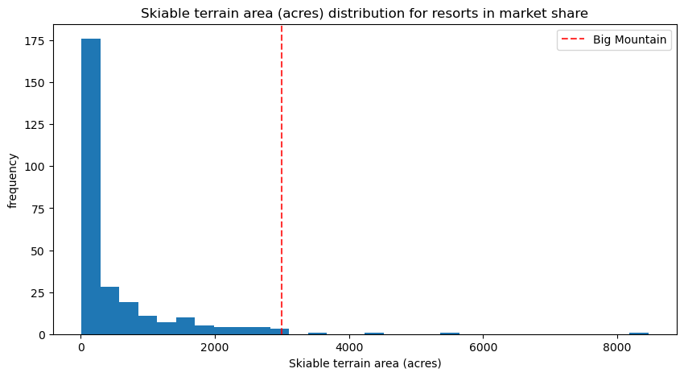
Modeling Results and Analysis (1/3)
A few things distinguish Big Mountain from the other ski resorts, and therefore warrant the recommended price increase. Within our condensed data set, Big Mountain has far and away the most acres of skiable terrain and is very high up the league.

Slide 5
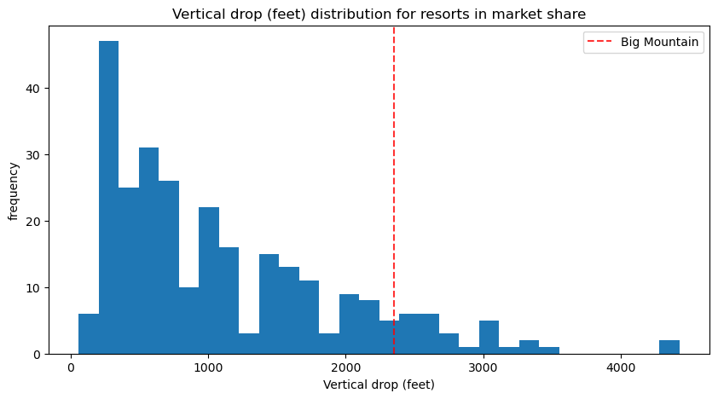
Modeling Results and Analysis (2/3)
The biggest vertical drop at Big Mountain Resort sets it apart from the majority of other ski resorts in our condensed data set. For the ski resorts in our data collection, Big Mountain Resort has an impressive vertical drop correlation.

Slide 6
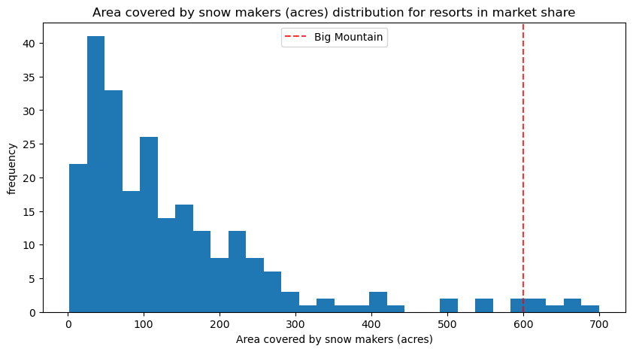
Modeling Results and Analysis (3/3)
In comparison to most other resorts, Big Mountain receives more snowfall on average. Withink our data collection, this chracterisitc and Adult Weekend pricing have a posite link.

Slide 7
Summary and Conclusion
Based on our model predictions and comparative analysis, we recommend increasing the adult weekend ticket price to $88.45, rounded to $89. This 9.2% increase aligns Big Mountain's pricing more closely with its features and market position, while remaining competitive within its peer group.

